Slide 1
Chapter 11 Inheritance and Encapsulation

Slide 2
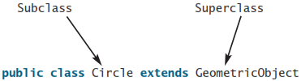
Declaring a Subclass
A subclass extends properties and methods from the superclass. You can also:
  Add new properties
  Add new methods
  Override the methods of the superclass

Slide 3
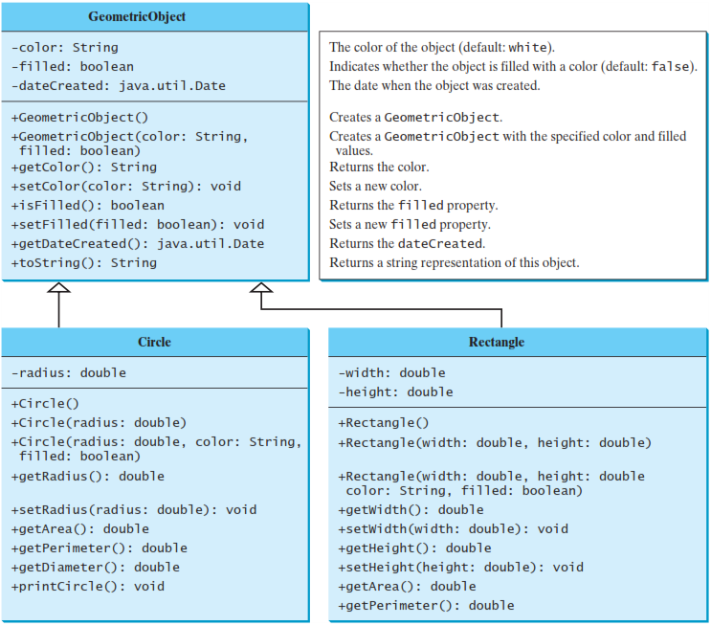
Superclasses and Subclasses
GeometricObject1
Circle4
Rectangle1
TestCircleRectangle
Run

Slide 4
Are superclass’s Constructor Inherited?
No. They are not inherited.
They are invoked explicitly or implicitly.
Explicitly using the super keyword.
A constructor is used to construct an instance of a class. Unlike properties and methods, a superclass's constructors are not inherited in the subclass. They can only be invoked from the subclasses' constructors, using the keyword super. If the keyword super is not explicitly used, the superclass's no-arg constructor is automatically invoked.

Slide 5

Using the Keyword super
The keyword super refers to the superclass of the class in which super appears. This keyword can be used in two ways:
To call a superclass constructor
To call a superclass method

Slide 6
CAUTION
You must use the keyword super to call the superclass constructor. Invoking a superclass constructor’s name in a subclass causes a syntax error.
Java requires that the statement that uses the keyword super appear first in the constructor.

Slide 7

Overriding vs. Overloading

Slide 8
The toString() method in Object
The toString() method returns a string representation of the object. The default implementation returns a string consisting of a class name of which the object is an instance, the at sign (@), and a number representing this object.
Loan loan = new Loan();
System.out.println(loan.toString());
The code displays something like Loan@15037e5 . This message is not very helpful or informative. Usually you should override the toString method so that it returns a digestible string representation of the object.

Slide 9
The instanceof Operator
Use the instanceof operator to test whether an object is an instance of a class:
  Object myObject = new Circle();
  // Some lines of code
  /**
  Perform casting if myObject is an instance of Circle
  */
  if (myObject instanceof Circle) {
  System.out.println("myObject is instance of Circle");
  ...
  }

Slide 10


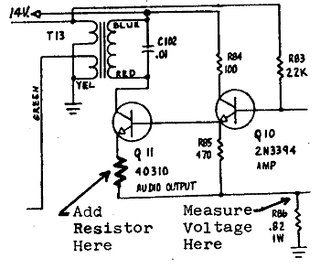
Encapsulation
encapsulation: Hiding implementation details from clients.
  Encapsulation forces abstraction.
    separates external view (behavior) from internal view (state)
    protects the integrity of an object's data

Slide 11
Private fields
A field that cannot be accessed from outside the class
  private type name;
  Examples:
  private int id;
  private String name;
Client code won't compile if it accesses private fields:

Slide 12
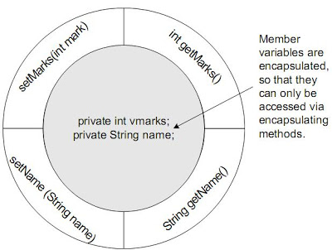
Accessing private state

Slide 13
Accessing private state
  // A "read-only" access to the x field
  public int getX() {
  return x;
  }
  // Allows clients to change the x field
  public void setX(int newX) {
  x = newX;
  }
  Client code will look more like this:
  System.out.println(p1.getX());
  p1.setX(14);

Slide 14
Example: Point class
  // A Point object represents an (x, y) location.
  public class Point {
  private int x;
  private int y;
  public Point(int initialX, int initialY) {
  x = initialX;
  y = initialY;
  }
  public int getX() {
  return x;
  }
  public int getY() {
  return y;
  }
  public double distanceFromOrigin() {
  return Math.sqrt(x * x + y * y);
  }
  public void setLocation(int newX, int newY) {
  x = newX;
  y = newY;
  }
  public void translate(int dx, int dy) {
  setLocation(x + dx, y + dy);
  }
  }

Slide 15
Benefits of encapsulation
Abstraction between object and clients
Protects object from unwanted access
  Example: Can't fraudulently increase an Account's balance.
Can constrain objects' state (invariants)
  Example: Only allow Accounts with non-negative balance.
  Example: Only allow Dates with a month from 1-12.

Slide 16
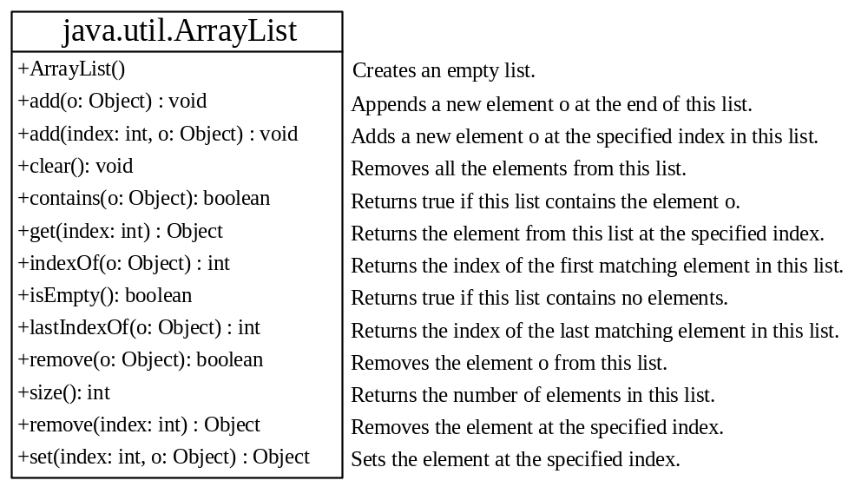
The ArrayList Class
You can create an array to store objects. But the array’s size is fixed once the array is created. Java provides the ArrayList class that can be used to store an unlimited number of objects.

Slide 17
ArrayList Example
TestArrayList
Run

Slide 18
The protected Modifier
The protected modifier can be applied on data and methods in a class. A protected data or a protected method in a public class can be accessed by any class in the same package or its subclasses.
Cannot be accessed if the subclasses are in a different package.
private, default, protected, public

Slide 19

Accessibility Summary

Slide 20

Visibility Modifiers

Slide 21
NOTE
the final modifier can also be used on local variables in a method. A final local variable is a constant inside a method.

Slide 22
The final Modifier
The final class cannot be extended:
final class Math {
...
}
The final variable is a constant:
final static double PI = 3.14159;
The final method cannot be
overridden by its subclasses.

